Slide 1
Nationalities Nacionalidades
Capítulo 1 (1.1)

Slide 2
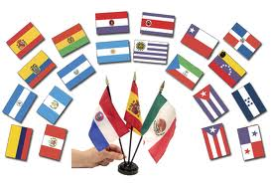
To state your or someone else's nationality
Use the verb ser.
Yo soy____________ (Soy argentino/a)
Tú eres____________(Eres boliviano/a)
Ella/él es_____________ (Es cubano/a)
Nosotros/as somos____(Somos peruanos/as)
Ellos/Ellas son_______(Son uruguayos/as)

Slide 3
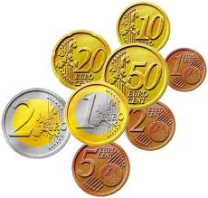
El euro
¿Por qué se usa el euro?
¿Cómo son?
A monetary unit that has replaced the individual currencies of the countries in the European Union.
Europeans live near international borders. Using the euro may be easier for the travelers, and for people doing business in different European countries.
Euro coins have a common symbol on one side, and unique symbols representing each country in the European union on the other.

Slide 4
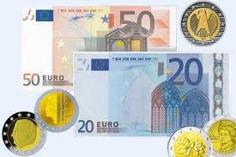
¿De cuánto son las dominaciones?
El euro comparado al dólar
Bills are designed into 5, 10, 20, 50, 100, 200, and 500 dominations.
1 euro= $1.22
The euro has a higher value.

