Slide 1
Making Nouns Plural Making articles plural
Chapter 2.1

Slide 2
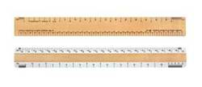
Making Nouns Plural
To make an noun plural
If the noun ends with a vowel (a,e,i,o,u)
If the noun ends with a consonant (all other letters)
add –s
Example: diccionario
diccionarios
Add –es
Example: papel
papeles

Slide 3
If a noun ends in z
Change the z to a c and add es
Example:
Lápiz lápices

Slide 4
Indefinite articles
To make an indefinite article plural
For masculine nouns use
For feminine nouns use
Unos
unas

Slide 5
Subject Pronouns
To say I
To say you
To say he
To say she
Yo
Tú
Él
Ella

