Slide 1
Preterite of Regular Verbs

Slide 2
Preterite tense
The preterite tense is used to tell what happened or what you did. (To talk about a past action)

Slide 3
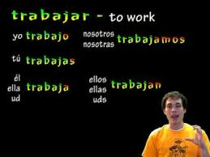
How to conjugate using the preterite tense
Just like the present tense, when you conjugate a regular verb you:
1st remove the root of the verb (-ar, -er, -ir)
2nd plug in the appropriate ending based on who did the action.

Slide 4
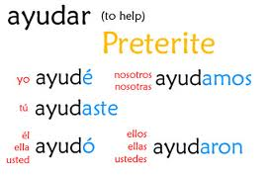
-ar endings
Yo
Tú
Él/ella/usted/ name
Nosotros/as
Ellos/ellas/ustedes
é
aste
ó
amos
aron

Slide 5
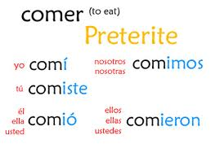
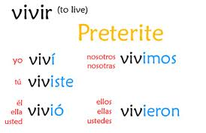
-er /ir verbs
Yo
Tú
Él/ella/usted/ name
Nosotros/as
Ellos/ellas/ustedes
í
iste
ió
imos
ieron

Slide 6
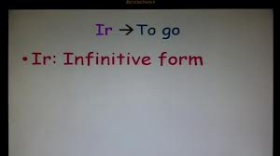
Conjugation of the verb Ir
The verb “Ir”
Conjugation in the preterite tense.
To go
Yo fui
Tú fuiste
Ella fue
Nosotros fuimos
Ellos fueron

Slide 7
To ask if someone if they already did an action…
Did you already….?
Example
Did you alread clean your room?
Ya…..?
Ya limpiaste tu cuarto?
Limpiar conjugated
In the preterite tense
tú form

Slide 8
To state that you already did something:
I already ….
Example
I already cleaned my room.
Sí, ya….
Sí, ya limpié mi cuarto.
Conjugated
In the preterite
Yo form

Slide 9
Stating that you have not done an action yet.
No, todavía no.

Slide 10
To ask…
When did you do it?
Vocabulario:
Last week
Last (day of the week)
Day before yesterday
Yesterday
Last night
This morning
¿Cuándo lo hiciste?
La semana pasada
El martes pasado
Anteayer
Ayer
Anoche
Esta mañana

Slide 11
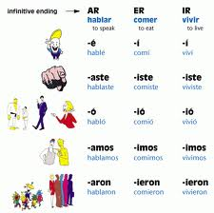
http://youtu.be/JhBOF_GlHTA
Catch the mistake in the –ir/-er endings

