Slide 1
Locations Where You Going?

Slide 2
LOCATIONS
The restaurant
The library
The post office
The house
The gym
The pool
The store
The supermarket
The movie theater
The park
El Restaurante
La biblioteca
El correo
La casa
El gimnasio
La piscina
La tienda
El supermercado
El cine
El parque

Slide 3
Estar:
Irregular verbs.
Not all verbs follow the conjugation pattern, these are known as irregular verbs.
Estar is an irregular verb and when conjugated, it does not follow the pattern.

Slide 4
To describe where you or others are use the verb Estar + en
I am
You are
He/she/you formal are
We are
They are
Estoy
Estás
Está
Estamos
Están

Slide 5
Ir: to go
The verb ir: to go
Ir is also an irregular verb when conjugated in the present tense

Slide 6
To describe where someone is going use the verb… Ir : to go
(I go)
(you go)
(He/she/it goes) (We go)
(They go)
Voy
Vas
Va
Vamos
Van

Slide 7
When stating where you or someone else is/are going, you must add “a” after the conjugated form of ir.
Voy a la tienda
Vas a la biblioteca
Vamos a la piscina

Slide 8
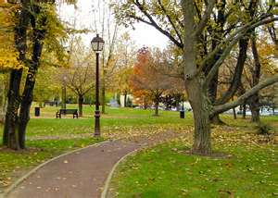
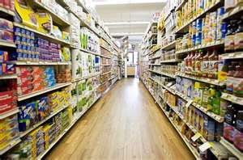
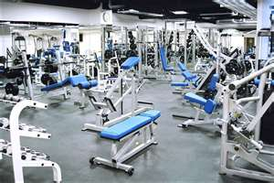
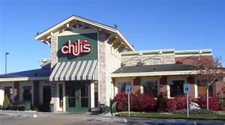
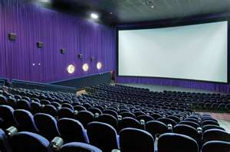
The contraction “al”
a + el makes a contraction
It becomes al
For all masculine locations the conjugated form of “ir” will be followed by the contraction of “al”

Slide 9
1. I go to the supermarket.
2. I go to the restaurant.
3. You go to the park.
Voy al supermercado.
Voy al restaurante
Vas al parque.

Slide 10
¿Adónde?
¿Adónde vas?
¿Adónde vamos?
¿Adónde van?
To where ?
Where are you going?
Where are we going?
Where are they going?

Slide 11
Vocabulario
Para: for or to
Película: movie
Ver: to see
Voy al cine para ver una película.
Voy a la biblioteca para estudiar.
Vamos al parque para descansar

