Slide 1
octubre: tarea
lunes | martes | miércoles | jueves | viernes | sábado | domingo
1 | 2 PLC | 3 Min Day | 4 | 5 | 6 | 7
8 | 9 PLC | 10 | 11 | 12 | 13 | 14
15 | 16 PLC | 17 | 18 | 19 | 20 | 21
22 | 23 PLC | 24 | 25 | 26 | 27 | 28
29 | 30 PLC | 31 |  |  | Parent Signiture: (10 pts) _________________
Homework x 5________
Not written x2 -_______
Total _______________

Slide 2
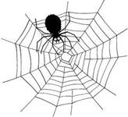
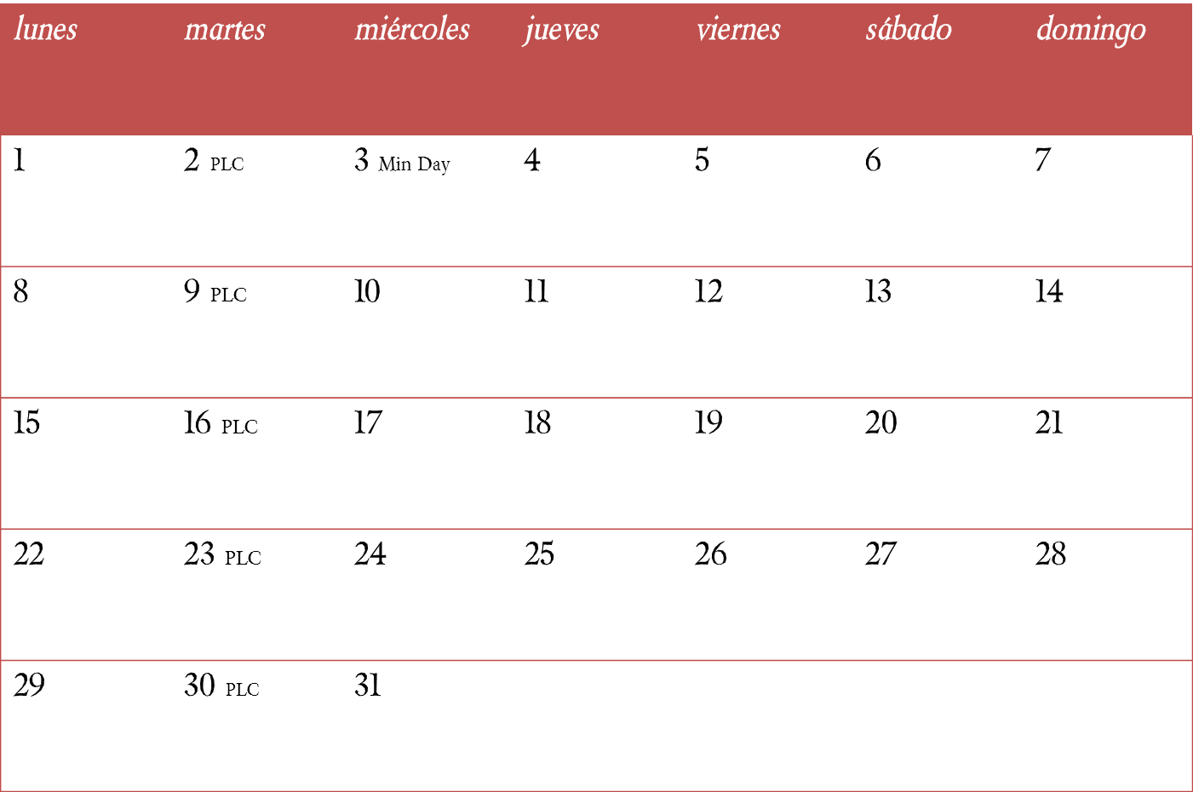
octubre: participación
Total points_________ Grade_______
Parent signature: (10 points)_________________

